Slide 1
Computer Networks Module-4
The Transport Protocols

Slide 2
Responsibilities of a Transport Layer
The Process to Process Delivery
End-to-End Connection between Hosts
Multiplexing and Demultiplexing
Congestion Control
Data integrity and Error correction
Flow control

Slide 3
THE TRANSPORT SERVICE
Services Provided to the Upper Layers
Transport Service Primitives

Slide 4
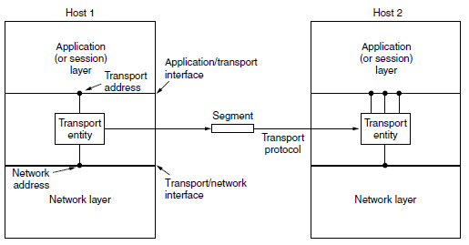
Services Provided to the Upper Layers (logical) relationship of the network, transport, and application layers

Slide 5
Cont,
The ultimate goal of the transport layer is to provide efficient, reliable, and cost-effective data transmission service to its users, normally processes in the application
layer.
To achieve this, the transport layer makes use of the services provided by the network layer.
The software and/or hardware within the transport
layer that does the work is called the transport entity.
The transport entity can be located in the operating system kernel, in a library package bound into network
applications, in a separate user process, or even on the network interface card

Slide 6
Two types of network service, connection-oriented and connectionless,
there are also two types of transport service.
The connection-oriented transport service is similar to the connection-oriented network service in many ways.
In both cases, connections have three phases: establishment, data transfer,
and release.
Addressing and flow control are also similar in both layers.
Furthermore, the connectionless transport service is also very similar to the connectionless network service.
However, note that it can be difficult to provide a connectionless transport service on top of a connection-oriented network service, since it is inefficient to set up a connection to send a single packet and then tear it
down immediately afterwards.

Slide 7
Transport Service Primitives
To allow users to access the transport service, the transport layer must provide some operations to application programs, that is, a transport service interface.
Each transport service has its own interface.

Slide 8
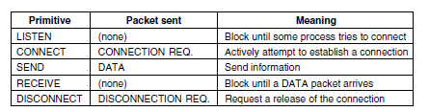
The primitives for a simple transport service.

Slide 9
Berkeley Sockets
Sockets were first released as part of the Berkeley UNIX 4.2BSD software distribution in 1983. They quickly became popular.
The primitives are now widely used for Internet programming on many operatingsystems, especially UNIX-based systems, and there is a socket-style API for Windows called ‘‘winsock.’’

Slide 10
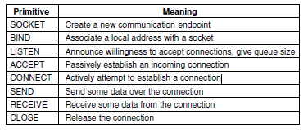
The socket primitives for TCP

Slide 11
The first four primitives in the list are executed in that order by servers.
TheSOCKET primitive creates a new endpoint and allocates table space for it within the transport entity
Newly created sockets do not have network addresses. These are assigned using the BIND primitive. Once a server has bound an address to a socket, remote clients can connect to it.
Next comes the LISTEN call, which allocates space to queue incoming calls for the case that several clients try to connect at the same time.
ACCEPT returns a file descriptor, which can be used for reading
and writing in the standard way, the same as for files.
Now let us look at the client side. Here, too, a socket must first be created
using the SOCKET primitive, but BIND is not required since the address used does not matter to the server.
The CONNECT primitive blocks the caller and actively starts the connection process. When it completes (i.e., when the appropriate segment is received from the server), the client process is unblocked and the connection is established.
Both sides can now use SEND and RECEIVE to transmit and receive data over the full-duplex connection.

Slide 12
ELEMENTS OF TRANSPORT PROTOCOLS
The transport service is implemented by a transport protocol used between the two transport entities.
Addressing
The method normally used is to define transport addresses to which processes
can listen for connection requests. In the Internet, these endpoints are called
ports.
We will use the generic term TSAP (Transport Service Access Point) to
mean a specific endpoint in the transport layer. The analogous endpoints in the
network layer (i.e., network layer addresses) are not-surprisingly called NSAPs
(Network Service Access Points).
IP addresses are examples of NSAPs.
Below Figure illustrates the relationship between the NSAPs, the TSAPs, and a
transport connection.

Slide 13
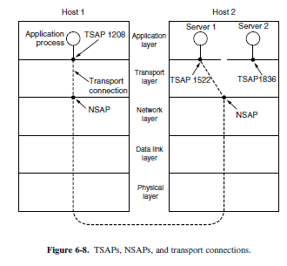
Cont,

Slide 14
Portmapper used to find the TSAP address
corresponding to a given service name, such as ‘‘BitTorrent,’’ a user sets up a connection
to the portmapper (which listens to a well-known TSAP).
The user then sends a message specifying the service name, and the portmapper sends back the TSAP address. Then the user releases the connection with the portmapper and establishes
a new one with the desired service.
The function of the portmapper is analogous to that of a directory assistance operator in the telephone system—it provides a mapping of names onto numbers.

Slide 15
Initial connection protocol
Instead of every conceivable server listening at a well-known TSAP, each machine that wishes to offer
services to remote users has a special process server that acts as a proxy for less heavily used servers. This server is called inetd on UNIX systems.
It listens to a set of ports at the same time, waiting for a connection request.
Potential users of a service begin by doing a CONNECT request, specifying the TSAP address of the service they want.
If no server is waiting for them, they get a connection to the process server, as shown in Fig. 6-9(a).

Slide 16
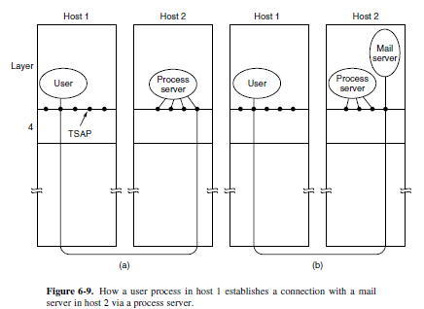

Slide 17
After it gets the incoming request, the process server spawns the requested server, allowing it to inherit the existing connection with the user.
The new server does the requested work, while the process server goes back to listening for new requests, as shown in Fig. 6-9(b).

Slide 18
Connection Establishment
Establishing a connection sounds easy, but it is actually surprisingly tricky.
At first glance, it would seem sufficient for one transport entity to just send a CONNECTION REQUEST segment to the destination and wait for a CONNECTION ACCEPTED reply.
The problem occurs when the network can lose, delay, corrupt, and duplicate packets. This behavior causes serious complications.

Slide 19
Cont,
Three-way handshake-This establishment protocol involves one peer checking with the other that the connection request is indeed current.
TCP uses this three-way handshake to establish connections.
Within a connection, a timestamp is used to extend the 32-bit sequence number so that it will not wrap within the maximum packet lifetime, even for gigabit-per-second connections.
This mechanism is a fix to TCP that was needed as it was used on faster and faster links.
It is described in RFC 1323 and called PAWS (ProtectionAgainst Wrapped Sequence numbers).
Across connections, for the initial sequence numbers and before PAWS can come into play, TCP originally used the clock-based scheme just described.
However, this turned out to have a security vulnerability.
The clock made it easy for an attacker to predict the next initial sequence number and send packets that tricked the three-way handshake and established a forged connection.
To close this hole, pseudorandom initial sequence numbers are used for connections in practice.

Slide 20
Connection Release
Releasing a connection is easier than establishing one.
There are two styles of terminating a connection: asymmetric release and symmetric release.
Asymmetric release is the way the telephone system works: when one party hangs up, the connection is broken.
Symmetric release treats the connection as two separate unidirectional connections and requires each one to be released separately.

Slide 21
Error Control and Flow Control
A frame carries an error-detecting code (e.g., a CRC or checksum) that is used to check if the information was correctly received.
A frame carries a sequence number to identify itself and is retransmitted
by the sender until it receives an acknowledgement of successful
receipt from the receiver. This is called ARQ (Automatic
Repeat reQuest).
There is a maximum number of frames that the sender will allow to
be outstanding at any time, pausing if the receiver is not acknowledging
frames quickly enough.
If this maximum is one packet the protocol is called stop-and-wait.
Larger windows enable pipelining and improve performance on long, fast links.
The sliding window protocol combines these features and is also
used to support bidirectional data transfer.

Slide 22
End-to-end argument.
According to this argument, the transport layer check that runs end-to-end is essential for correctness, and the link layer checks are not essential but nonetheless valuable for improving performance

Slide 23
Multiplexing
Multiplexing, or sharing several conversations over connections, virtual circuits, and physical links plays a role in several layers of the network architecture.
In the transport layer, the need for multiplexing can arise in a number of ways.
For example, if only one network address is available on a host, all transport connections on that machine have to use it. When a segment comes in, some way is needed to tell which process to give it to. This situation, called multiplexing, is shown in Fig. 6-17(a).
In this figure, four distinct transport connections all use the same network connection (e.g., IP address) to the remote host.
Multiplexing can also be useful in the transport layer for another reason. Suppose, for example, that a host has multiple network paths that it can use.
If a user needs more bandwidth or more reliability than one of the network paths can provide,a way out is to have a connection that distributes the traffic among multiple network paths on a round-robin basis, as indicated in Fig. 6-17(b).
This modus operandi is called inverse multiplexing. With k network connections open, the
effective bandwidth might be increased by a factor of k.
An example of inverse multiplexing is SCTP (Stream Control Transmission Protocol), which can run
a connection using multiple network interfaces.
In contrast, TCP uses a single network endpoint. Inverse multiplexing is also found at the link layer, when several low-rate links are used in parallel as one high-rate link.

Slide 24
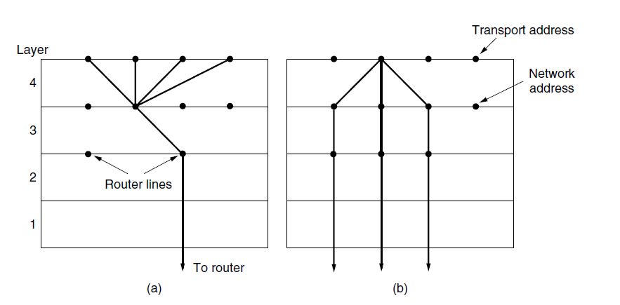
(a) Multiplexing(b) Inverse Multiplexing

Slide 25
Crash Recovery
If hosts and routers are subject to crashes or connections are long-lived (e.g.,large software or media downloads), recovery from these crashes becomes an issue.
If the transport entity is entirely within the hosts, recovery from network and router crashes is straightforward.
The transport entities expect lost segments all the time and know how to cope with them by using retransmissions.

Slide 26
THE INTERNET TRANSPORT PROTOCOLS: UDP
The Internet has two main protocols in the transport layer, a connectionless protocol and a connection-oriented one.

Slide 27
Introduction
The Internet protocol suite supports a connectionless transport protocol called UDP (User Datagram Protocol).
UDP provides a way for applications to send encapsulated IP datagrams without having to establish a connection. UDP is described in RFC 768.
UDP transmits segments consisting of an 8-byte header followed by the payload. The header is shown in Fig. 6-27.
The two ports serve to identify the endpoints within the source and destination machines.
When a UDP packet arrives, its payload is handed to the process attached to the destination port.
This attachment occurs when the BIND primitive or something similar is used.

Slide 28
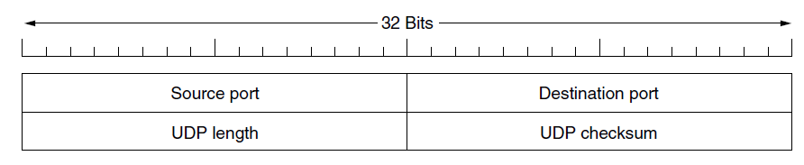
The UDP header

Slide 29
Cont,
The main value of UDP over just using raw IP is the addition of the source and destination ports.
Without the port fields, the transport layer would not know what to do with each incoming packet.
With them, it delivers the embedded segment to the correct application.
The source port is primarily needed when a reply must be sent back to the
source.
By copying the Source port field from the incoming segment into the Destination port field of the outgoing segment, the process sending the reply can specify which process on the sending machine is to get it.
The UDP length field includes the 8-byte header and the data.
The minimum length is 8 bytes, to cover the header.
The maximum length is 65,515 bytes, which is lower than the largest number that will fit in 16 bits because of the size limit on P packets.
An optional Checksum is also provided for extra reliability. It checksums the header, the data, and a conceptual IP pseudoheader.

Slide 30
Remote Procedure Call
Sending a message to a remote host and getting a reply back is a lot like making a function call in a programming language.
In both cases, you start with one or more parameters and you get back a result.
This observation has led people to try to arrange request-reply interactions on networks to be cast in the form of procedure calls.
Such an arrangement makes network applications much easier to program and more familiar to deal with.

Slide 31
Cont,
Birrell and Nelson suggested was allowing programs to call procedures located on remote hosts.
When a process on machine 1 calls a procedure on machine 2, the calling process on 1 is suspended and execution of the called procedure takes place on 2.
Information can be transported from the caller to the callee
in the parameters and can come back in the procedure result.
No message passing is visible to the application programmer.
This technique is known as RPC (Remote Procedure Call) and has become the basis for many networking applications

Slide 32
The idea behind RPC is to make a remote procedure call look as much as possible like a local one.
In the simplest form, to call a remote procedure, the client program must be bound with a small library procedure, called the client stub, that represents the server procedure in the client’s address space.
Similarly, the server is bound with a procedure called the server stub.
These procedures hide the fact that the procedure call from the client to the server is not local.

Slide 33
The actual steps in making an RPC are shown in Fig. 6-29.
Step 1 is the client calling the client stub. This call is a local procedure call, with the parameters pushed onto the stack in the normal way.
Step 2 is the client stub packing the parameters into a message and making a system call to send the message. Packing the parameters is called marshaling.
Step 3 is the operating system sending the message from the client machine to the server machine.
Step 4 is the operating system passing the incoming packet to the server stub.
Finally, step 5 is the server stub calling the server procedure with the unmarshaled parameters.
The reply traces the same path in the other direction.

Slide 34
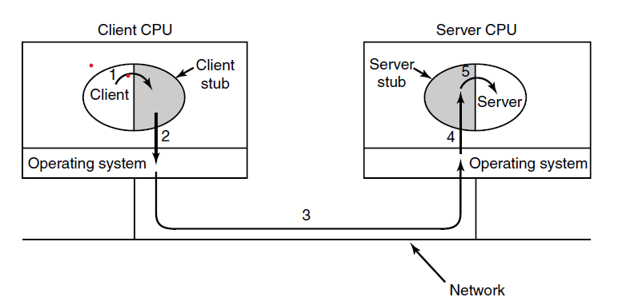
Steps in making a remote procedure call. The stubs are shaded.

Slide 35
Real-Time Transport Protocols
It is described in RFC 3550 and is now in widespread use for multimedia applications.
Two aspects of real-time transport :
The first is the RTP protocol for transporting
audio and video data in packets.
The second is the processing that takes place,
mostly at the receiver, to play out the audio and video at the right time.

Slide 36
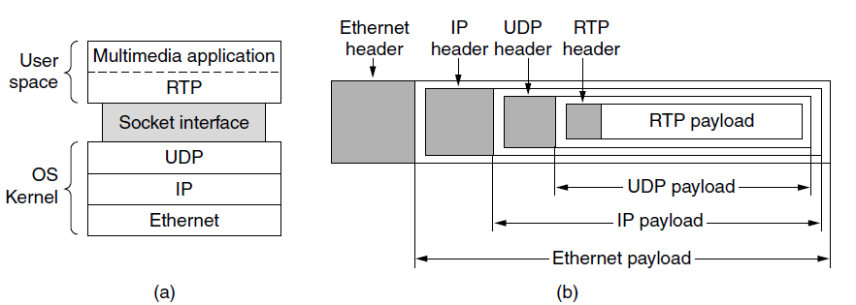
(a) The position of RTP in the protocol stack. (b) Packet nesting.

Slide 37
The basic function of RTP is to multiplex several real-time data streams onto a single stream of UDP packets.
The UDP stream can be sent to a single destination (unicasting) or to multiple destinations (multicasting).
Because RTP just uses normal UDP, its packets are not treated specially by the routers unless some normal IP quality-of-service features are enabled.

Slide 38
RTCP—The Real-time Transport Control Protocol
RTP has a little sister protocol (little sibling protocol?) called RTCP (Realtime Transport Control Protocol).
It is defined along with RTP in RFC 3550 and handles feedback, synchronization, and the user interface.
It does not transport any media samples.
The first function can be used to provide feedback on delay, variation in delay or jitter, bandwidth, congestion, and other network properties to the sources.
This information can be used by the encoding process to increase the data rate (and give better quality) when the network is functioning well and to cut back the datarate when there is trouble in the network

Slide 39
THE INTERNET TRANSPORT PROTOCOLS: TCP Introduction to TCP
TCP (Transmission Control Protocol) was specifically designed to provide a reliable end-to-end byte stream over an unreliable internetwork.
An internetwork differs from a single network because different parts may have wildly different topologies, bandwidths, delays, packet sizes, and other parameters.
TCP was designed to dynamically adapt to properties of the internetwork and to be robust in the face of many kinds of failures.
TCP was formally defined in RFC 793 in September 1981. As time went on, many improvements have been made, and various errors and inconsistencies have been fixed.
To give you a sense of the extent of TCP, the important RFCs are now RFC 793 plus: clarifications and bug fixes in RFC 1122;
extensions for high-performance in RFC 1323;
selective acknowledgements in RFC 2018;
Congestion control in RFC 2581;
repurposing of header fields for quality of service in
RFC 2873; improved retransmission timers in RFC 2988; and
explicit congestion notification in RFC 3168.
The full collection is even larger, which led to a guide to the many RFCs, published of course as another RFC document, RFC 4614.

Slide 40
The TCP Service Model
TCP service is obtained by both the sender and the receiver creating end points, called sockets.
Each socket has a socket number (address) consisting of the IP address of the host and a 16-bit number local to that host, called a port.
A port is the TCP name for a TSAP.
For TCP service to be obtained, a connection must be explicitly established between a socket on one machine and a socket on another machine.
A socket may be used for multiple connections at the same time.
In other words, two or more connections may terminate at the same socket.
Connections are identified by the socket identifiers at both ends, that is, (socket1, socket2).
No virtual circuit numbers or other identifiers are used.
Port numbers below 1024 are reserved for standard services that can usually
only be started by privileged users (e.g., root in UNIX systems).
They are called well-known ports. For example, any process wishing to remotely retrieve mail from a host can connect to the destination host’s port 143 to contact its IMAP daemon.

Slide 41
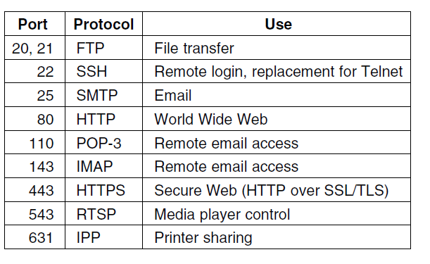
Some assigned ports.

Slide 42
Cont,
All TCP connections are full duplex and point-to-point.
Full duplex means that traffic can go in both directions at the same time.
Point-to-point means that each connection has exactly two end points. TCP does not support multicasting or broadcasting.
A TCP connection is a byte stream, not a message stream.
Message boundaries are not preserved end to end.
For example, if the sending process does four 512-byte writes to a TCP stream, these data may be delivered to the receiving process as four 512-byte chunks, two 1024-byte chunks, one 2048-byte chunk , or some other way.
There is no way for the receiver to detect the unit(s) in which the data were written, no matter how hard it tries.

Slide 43
The TCP Protocol
The sending and receiving TCP entities exchange data in the form of segments.
A TCP segment consists of a fixed 20-byte header (plus an optional part) followed by zero or more data bytes.
The TCP software decides how big segments
should be.
It can accumulate data from several writes into one segment or can split data from one write over multiple segments
Two limits restrict the segment size.
First, each segment, including the TCP header, must fit in the 65,515-
byte IP payload.
Second, each link has an MTU (Maximum Transfer Unit).
Each segment must fit in the MTU at the sender and receiver so that it can be sent and received in a single, unfragmented packet.

Slide 44
The basic protocol used by TCP entities is the sliding window protocol with a dynamic window size.
When a sender transmits a segment, it also starts a timer.
When the segment arrives at the destination, the receiving TCP entity sends back a segment (with data if any exist, and otherwise without) bearing an acknowledgement number equal to the next sequence number it expects to receive and the remaining window size.
If the sender’s timer goes off before the acknowledgement
is received, the sender transmits the segment again.

Slide 45
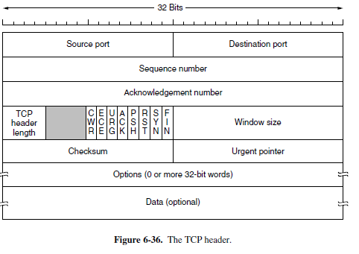
The TCP Segment Header

Slide 46
Cont,
The Source port and Destination port fields identify the local end points of the connection.
A TCP port plus its host’s IP address forms a 48-bit unique end point.
The source and destination end points together identify the connection.
This connection identifier is called a 5 tuple because it consists of five pieces of information: the protocol (TCP), source IP and source port, and destination IP and destination port.
The Sequence number and Acknowledgement number fields perform their usual functions. Note that the latter specifies the next in-order byte expected, not the last byte correctly received.
It is a cumulative acknowledgement because it summarizes the received data with a single number.
The TCP header length tells how many 32-bit words are contained in the TCP header.
This information is needed because the Options field is of variable length,
so the header is, too. Technically, this field really indicates the start of the data within the segment, measured in 32-bit words, but that number is just the header length in words, so the effect is the same.

Slide 47
Cont,
Now come eight 1-bit flags. CWR and ECE are used to signal congestion when ECN (Explicit Congestion Notification) is used, as specified in RFC 3168.
ECE is set to signal an ECN-Echo to a TCP sender to tell it to slow down when the TCP receiver gets a congestion indication from the network.
CWR is set to signal Congestion Window Reduced from the TCP sender to the TCP receiver so that it knows the sender has slowed down and can stop sending the ECN-Echo.
URG is set to 1 if the Urgent pointer is in use. The Urgent pointer is used to indicate a byte offset from the current sequence number at which urgent data are to be found.
The ACK bit is set to 1 to indicate that the Acknowledgement number is valid.
The PSH bit indicates PUSHed data. The receiver is hereby kindly requested
to deliver the data to the application upon arrival and not buffer it until a full buffer has been received (which it might otherwise do for efficiency).
The RST bit is used to abruptly reset a connection that has become confused
due to a host crash or some other reason
The SYN bit is used to establish connections
The FIN bit is used to release a connection
Flow control in TCP is handled using a variable-sized sliding window.
The Window size field tells how many bytes may be sent starting at the byte acknowledged.
A Window size field of 0 is legal and says that the bytes up to and including Acknowledgement number − 1 have been received, but that the receiver has not had a chance to consume the data and would like no more data for the moment, thank you.
The receiver can later grant permission to send by transmitting a segment with the same Acknowledgement number and a nonzero Window size field.
A Checksum is also provided for extra reliability. It checksums the header, the data, and a conceptual pseudoheader in exactly the same way as UDP, except that the pseudoheader has the protocol number for TCP (6) and the checksum is mandatory.
The Options field provides a way to add extra facilities not covered by the regular header
A widely used option is the one that allows each host to specify the MSS (Maximum Segment Size) it is willing to accept
The window scale option allows the sender and receiver to negotiate a window scale factor at the start of a connection.
The timestamp option carries a timestamp sent by the sender and echoed by the receiver.
The PAWS (Protection Against Wrapped Sequence numbers) scheme discards arriving segments with old timestamps to prevent this problem.
Finally, the SACK (Selective ACKnowledgement) option lets a receiver tell a sender the ranges of sequence numbers that it has received.

Slide 48
TCP Connection Establishment
To establish a connection, one side, say, the server, passively waits for an incoming connection by executing the LISTEN and ACCEPT primitives in that order, either specifying a specific source or nobody in particular.
The other side, say, the client, executes a CONNECT primitive, specifying the IP address and port to which it wants to connect, the maximum TCP segment size it is willing to accept, and optionally some user data (e.g., a password).
The CONNECT primitive sends a TCP segment with the SYN bit on and ACK bit off and waits for a response.
When this segment arrives at the destination, the TCP entity there checks to
see if there is a process that has done a LISTEN on the port given in the Destination
port field.
If not, it sends a reply with the RST bit on to reject the connection.
If some process is listening to the port, that process is given the incoming
TCP segment.
It can either accept or reject the connection. If it accepts, an acknowledgement
segment is sent back.
The sequence of TCP segments sent in the normal case is shown in Fig. 6-37(a).
Note that a SYN segment consumes 1 byte of sequence space so that it can be acknowledged unambiguously
In the event that two hosts simultaneously attempt to establish a connection between the same two sockets, the sequence of events is as illustrated in Fig. 6-37(b).
The result of these events is that just one connection is established, not two, because connections are identified by their end points.
If the first setup results in a connection identified by (x, y) and the second one does too, only one table entry is made, namely, for (x, y).

Slide 49
A vulnerability with implementing the three-way handshake is that the listening process must remember its sequence number as soon it responds with its own SYN segment.
This means that a malicious sender can tie up resources on a host by sending a stream of SYN segments and never following through to complete the connection.
This attack is called a SYN flood, and it crippled many Web servers in the 1990s.
One way to defend against this attack is to use SYN cookies.
Instead of remembering the sequence number, a host chooses a cryptographically generated sequence number, puts it on the outgoing segment, and forgets it.
If the three-way handshake completes, this sequence number (plus 1) will be returned to the host.
It can then regenerate the correct sequence number by running the same cryptographic function, as long as the inputs to that function are known.

Slide 50
TCP Connection Release
To release a connection, either party can send a TCP segment with the FIN bit set, which means that it has no more data to transmit.
When the FIN is acknowledged, that direction is shut down for new data.
Data may continue to flow indefinitely in the other direction, however.
When both directions have been shut down, the connection is released.

Slide 51
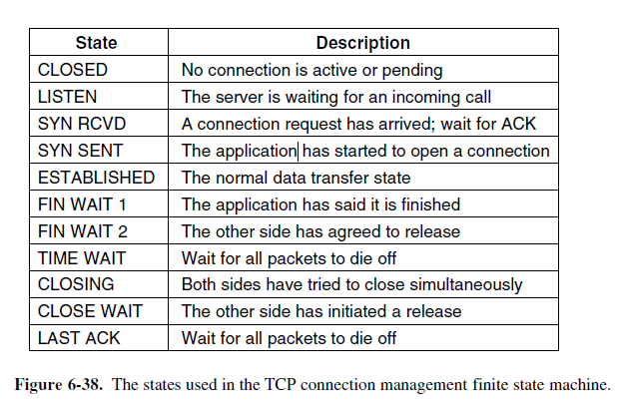
TCP Connection Management Modeling

Slide 52
TCP Connection Management Modeling
Each connection starts in the CLOSED state. It leaves that state when it does either a passive open (LISTEN) or an active open (CONNECT).
If the other side does the opposite one, a connection is established and the state becomes ESTABLISHED.
Connection release can be initiated by either side.
When it is complete, the state returns to CLOSED.

Slide 53
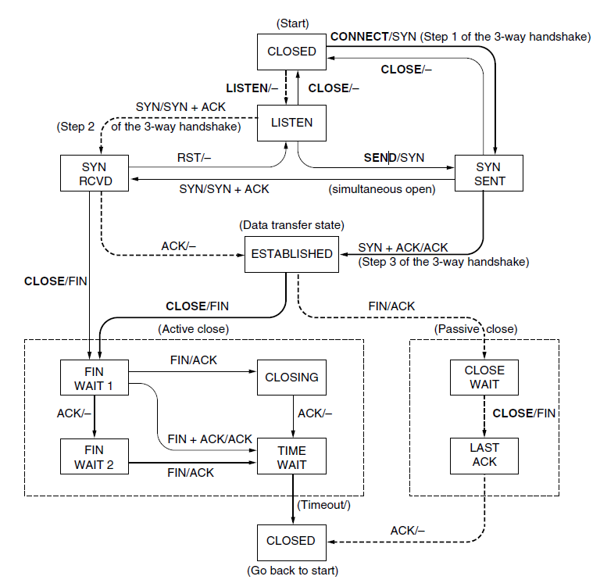
TCP connection management finite state machine. The heavy solid line is the normal path for a client. The heavy dashed line is the normal path for a server. The light lines are unusual events. Each transition is labeled with the event causing it and the action resulting from it, separated by a slash.

Slide 54
TCP Sliding Window
Window management in TCP decouples the issues of acknowledgement of the correct receipt of segments and receiver buffer allocation.
For example, suppose the receiver has a 4096-byte buffer, as shown in Fig. 6-40.
If the sender transmits a 2048-byte segment that is correctly received, the receiver will acknowledge the segment.
However, since it now has only 2048 bytes of buffer space (until the application removes some data from the buffer), it will advertise a window of 2048 starting at the next byte expected.
Now the sender transmits another 2048 bytes, which are acknowledged, but the advertised window is of size 0.
The sender must stop until the application process on the receiving host has removed some data from the buffer, at which time TCP can advertise a larger window and more data can be sent.

Slide 55
When the window is 0, the sender may not normally send segments, with two exceptions. First, urgent data may be sent, for example, to allow the user to kill the process running on the remote machine.
Second, the sender may send a 1-byte segment to force the receiver to reannounce the next byte expected and the window size.
This packet is called a window probe.
The TCP standard explicitly provides this option to prevent deadlock if a window update ever gets lost
One approach that many TCP implementations use to optimize this situation is called delayed acknowledgements.
The idea is to delay acknowledgements and window updates for up to 500 msec in the hope of acquiring some data on which to hitch a free ride.

Slide 56
TCP Timer Management
TCP uses multiple timers (at least conceptually) to do its work.
The most important of these is the RTO (Retransmission TimeOut).
When a segment is sent, a retransmission timer is started. If the segment is acknowledged before the timer expires, the timer is stopped.
If, on the other hand, the timer goes off before the acknowledgement comes in, the segment is retransmitted (and the timer os started again)
The expected delay is measured inmicroseconds and is highly predictable (i.e., has a low variance), so the timer can be set to go off just slightly after the acknowledgement is expected,.
The probability density function for the time it takes for a TCP acknowledgement to come back looks more
For each connection, TCP maintains a variable, SRTT (Smoothed Round-Trip Time), that is the best current estimate of the round-trip time to the destination in question.
When a segment is sent, a timer is started, both to see how long the acknowledgement takes and also to trigger a retransmission if it takes too long.
If the acknowledgement gets back before the timer expires, TCP measures how long the acknowledgement took, say, R. It then updates SRTT according to the formula
SRTT = α SRTT + (1 − α) R
where α is a smoothing factor that determines how quickly the old values are forgotten.
Typically, α = 7/8. This kind of formula is an EWMA (Exponentially Weighted Moving Average) or low-pass filter that discards noise in the samples.

Slide 57
Cont,
RTTVAR (Round-Trip Time VARiation) that is updated using the formula
RTTVAR = β RTTVAR + (1 − β) |SRTT − R |
This is an EWMA as before, and typically β = 3/4.
The retransmission timeout,RTO, is set to be
RTO = SRTT + 4 × RTTVAR
Karn’s approach solves the issue of obtaining accurate round-trip time estimates for messages while utilizing the Transmission Control Protocol (TCP) in computer networking.
Persistent Timer – To deal with a zero-window-size deadlock situation, TCP uses a persistence timer. When the sending TCP receives an acknowledgment with a window size of zero, it starts a persistence timer. When the persistence timer goes off, the sending TCP sends a special segment called a probe.
Keep Alive Timer – A keepalive timer is used to prevent a long idle connection between two TCPs. If a client opens a TCP connection to a server transfers some data and becomes silent the client will crash. In this case, the connection remains open forever. So a keepalive timer is used. Each time the server hears from a client, it resets this timer.
Time Wait Timer – This timer is used during tcp connection termination. The timer starts after sending the last Ack for 2nd FIN and closing the connection.

Slide 58
TCP Congestion Control
TCP maintains a congestion window whose size is the number of bytes the sender may have in the network at any time.
The corresponding rate is the window size divided by the round-trip time of the connection.
TCP adjusts the size of the window according to the AIMD rule(AIMD (Additive Increase Multiplicative
Decrease) control law in response to binary congestion signals from the network would converge to a fair and efficient bandwidth allocation.).
Recall that the congestion window is maintained in addition to the flow control window, which specifies the number of bytes that the receiver can buffer.

Slide 59
The Future of TCP
Many versions are deployed with slightly different implementations than the classic algorithms we have described, especially for congestion control and robustness against attacks.
The first one is that TCP does not provide the transport semantics that all applications want.
TCP with its standard sockets interface does not meet these needs
well.
Essentially, the application has the burden of dealing with any problem not solved by TCP.
This has led to proposals for new protocols that would provide a
slightly different interface.
Two examples are SCTP (Stream Control Transmission Protocol), defined in RFC 4960, and SST (Structured Stream Transport)(Ford, 2007).
The second issue is congestion control. You may have expected that this is a solved problem after our deliberations and the mechanisms that have been developed over time.
The form of TCP congestion control that we described, and which is widely used, is based on packet losses as a signal of congestion.

Slide 60
PERFORMANCE ISSUES
six aspects of network performance:
1. Performance problems.
2. Measuring network performance.
3. Host design for fast networks.
4. Fast segment processing.
5. Header compression.
6. Protocols for ‘‘long fat’’ networks.

Slide 61
performance problems
Some performance problems, such as congestion, are caused by temporary resource overloads.
If more traffic suddenly arrives at a router than the router can handle, congestion will build up and performance will suffer.
Performance also degrades when there is a structural resource imbalance.
Overloads can also be synchronously triggered.

Slide 62
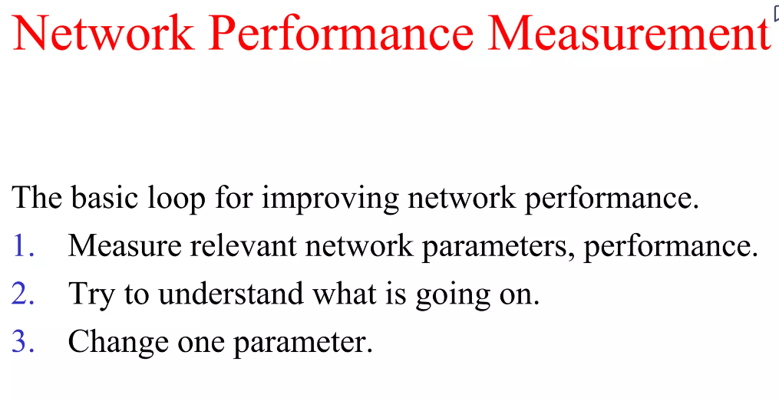
Cont,

Slide 63
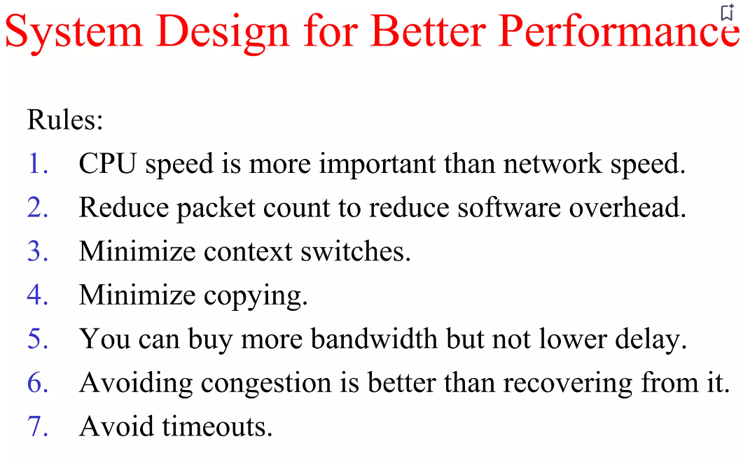
Cont,

Slide 64
Fast Segment Processing
Segment processing overhead has two components: overhead per segment and overhead per byte.
Both must be attacked. The key to fast segment processing is to separate out the normal, successful case (one-way data transfer) and handle it specially.
Many protocols tend to emphasize what to do when something goes wrong (e.g., a packet getting lost), but to make the protocols run fast, the designer should aim to minimize processing time when everything goes right.
Minimizing processing time when an error occurs is secondary.

Slide 65
Header Compression
ROHC (RObust Header Compression) is a modern version of header compression that is defined as a framework in RFC 5795.
It is designed to tolerate the loss that can occur on
wireless links.
There is a profile for each set of protocols to be compressed, such as IP/UDP/RTP.
Compressed headers are carried by referring to a context, which is essentially a connection; header fields may easily be predicted for packets of the same connection, but not for packets of different connections

Slide 66
Protocols for Long Fat Networks
The problem is that many protocol designers simply assumed, without stating it, that the time required to use up the entire sequence space would greatly exceed the maximum packet lifetime.
Consequently, there was no need to even worry about the problem of old duplicates still existing when the sequence numbers wrapped around.
A second problem is that the size of the flow control window must be greatly increased.

Slide 67
Assignment
Distance vector routing
Link state routing
Internet protocol-UDP
Internet protocol-TCP
Domain Name System
Electronic Mail
World Wide Web

